Slide 1
ITNW 1335 Cloud Computing
Chapter 11 – Fundamental Cloud Architectures

Slide 2
Fundamental Cloud Architectures
This chapter introduces and describes several of the more common foundational cloud architectural models, each exemplifying a common usage and characteristic of contemporary cloud-based environments
The involvement and importance of different combinations of cloud computing mechanisms in relation to these architectures are explored
They include:
Workload Distribution Architecture
Resource Pooling Architecture
Dynamic Scalability Architecture
Elastic Resource Capacity Architecture
Service Load Balancing Architecture
Cloud Bursting Architecture
Elastic Disk Provisioning Architecture
Redundant Storage Architecture

Slide 3
11.1. Workload Distribution Architecture
A load balancer can be use to the horizontally scale identical IT resources
Using runtime logic, workload will be distributed evenly
The resulting workload distribution architecture reduces both IT resource over-utilization and under-utilization to an extent dependent upon the sophistication of the load balancing algorithms and runtime logic
The diagram on the next slide is a fundamental architectural model can be applied to any IT resource, with workload distribution commonly carried out in support of distributed virtual servers, cloud storage devices, and cloud services

Slide 4
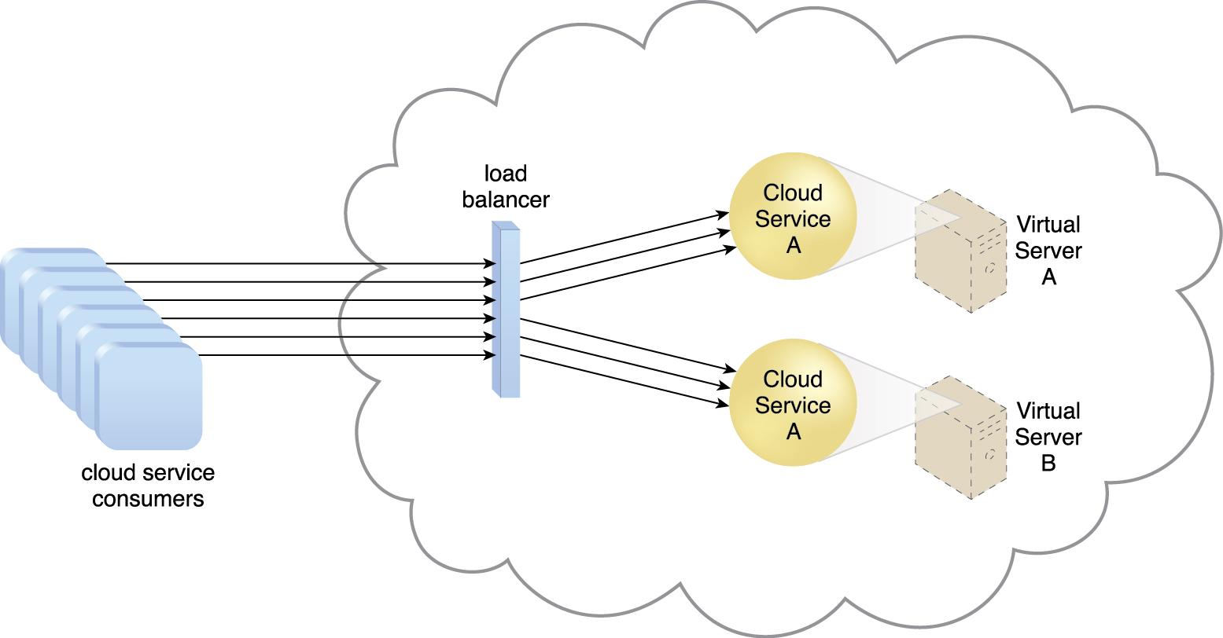
11.1. Workload Distribution Architecture
Load balancing systems can be applied to specific IT resources such as:
the service load balancing architecture
the load balanced virtual server architecture
the load balanced virtual switches architecture
Figure 11.1 A redundant copy of Cloud Service A is implemented on Virtual Server B. The load balancer intercepts cloud service consumer requests and directs them to both Virtual Servers A and B to ensure even workload distribution.
Notes:
Figure:

Slide 5
11.1. Workload Distribution Architecture
Other mechanism that may assist in workload distribution are:
Audit Monitor – When distributing runtime workloads, the type and geographical location of the IT resources that process the data can determine whether monitoring is necessary to fulfill legal and regulatory requirements.
Cloud Usage Monitor – Various monitors can be involved to carry out runtime workload tracking and data processing.
Hypervisor – Workloads between hypervisors and the virtual servers that they host may require distribution
Logical Network Perimeter – The logical network perimeter isolates cloud consumer network boundaries in relation to how and where workloads are distributed
Resource Cluster – Clustered IT resources in active/active mode are commonly used to support workload balancing between different cluster nodes
Resource Replication – This mechanism can generate new instances of virtualized IT resources in response to runtime workload distribution demands

Slide 6
11.2. Resource Pooling Architecture
A resource pooling architecture is based on the use of one or more resource pools, in which identical IT resources are grouped and maintained by a system that automatically ensures that they remain synchronized
Physical server pools are composed of networked servers that have been installed with operating systems and other necessary programs and/or applications and are ready for immediate use
Virtual server pools are usually configured using one of several available templates chosen by the cloud consumer during provisioning
Storage pools, or cloud storage device pools, consist of file-based or block-based storage structures that contain empty and/or filled cloud storage devices
Notes:
Figure:

Slide 7
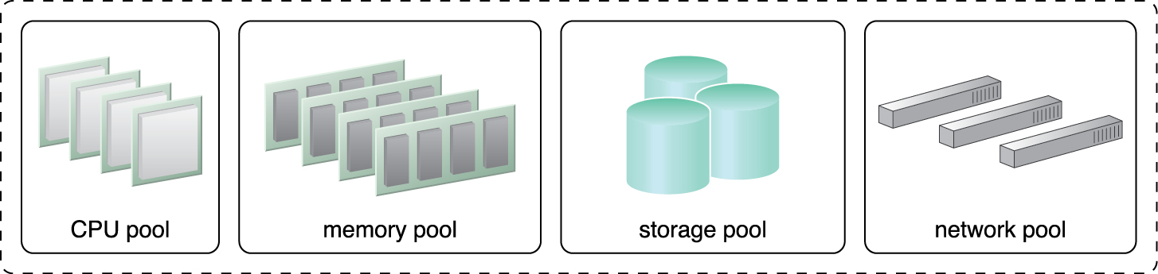
11.2. Resource Pooling Architecture
A resource pooling architecture (cont.)
Network pools (or interconnect pools) are composed of different preconfigured network connectivity devices.
CPU pools are ready to be allocated to virtual servers, and are typically broken down into individual processing cores
Pools of physical RAM can be used in newly provisioned physical servers or to vertically scale physical servers.
Dedicated pools can be created for each type of IT resource and individual pools can be grouped into a larger pool, in which case each individual pool becomes a sub-pool
Figure 11.2 A sample resource pool that is comprised of four sub-pools of CPUs, memory, cloud storage devices, and virtual network devices.
Notes:
Figure:

Slide 8
11.2. Resource Pooling Architecture
Resource pools can become highly complex, with multiple pools created for specific cloud consumers or applications
A hierarchical structure can be established to form parent, sibling, and nested pools in order to facilitate the organization of diverse resource pooling requirements
Notes:
Figure:

Slide 9
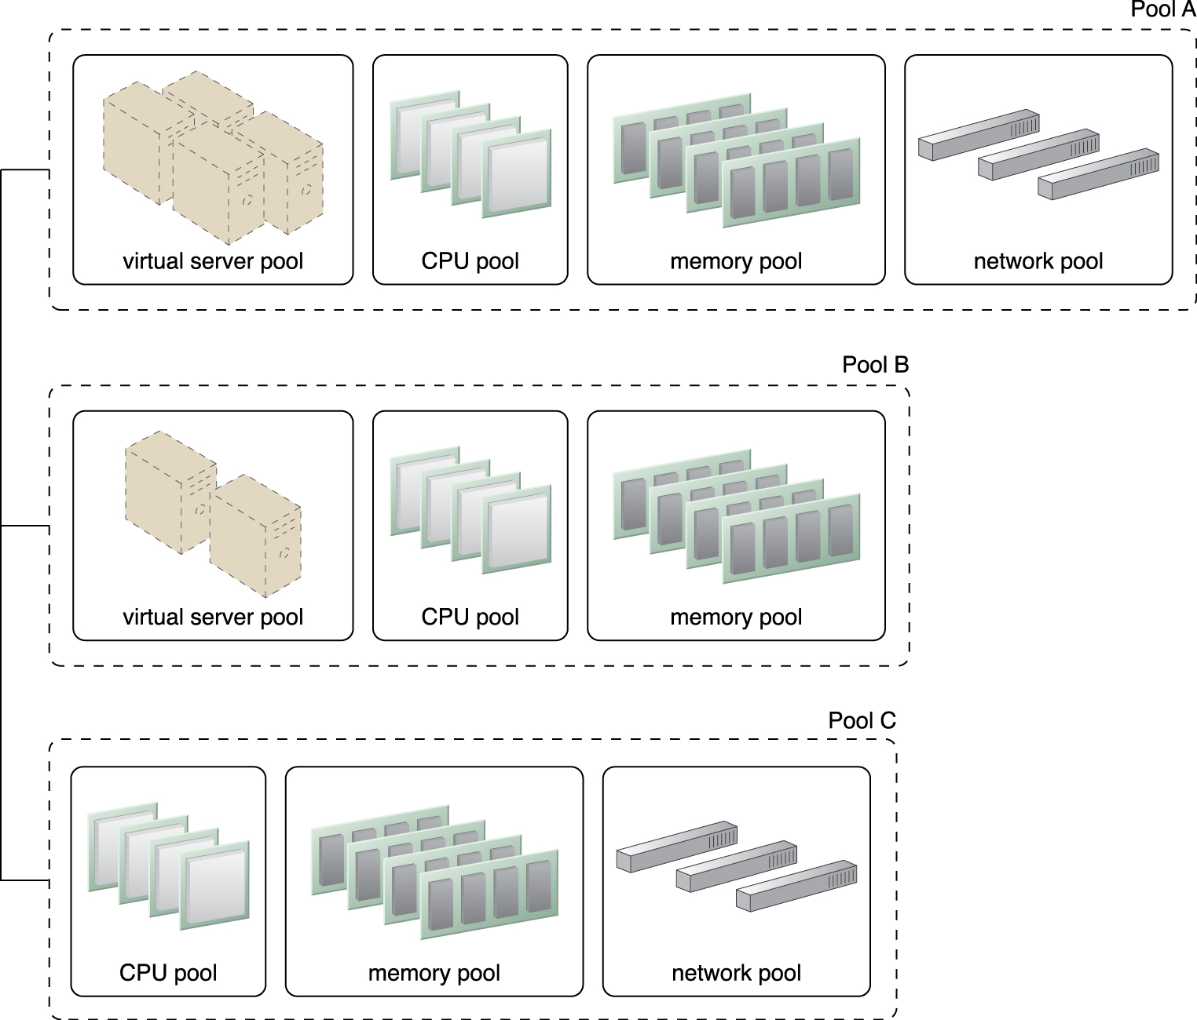
11.2. Resource Pooling Architecture
Sibling resource pools are usually drawn from physically grouped IT resources, as opposed to IT resources that are spread out over different data centers
Sibling pools are isolated from one another so that each cloud consumer is only provided access to its respective pool
Figure 11.3 Pools B and C are sibling pools that are taken from the larger Pool A, which has been allocated to a cloud consumer. This is an alternative to taking the IT resources for Pool B and Pool C from a general reserve of IT resources that is shared throughout the cloud.
Notes:
Figure:

Slide 10
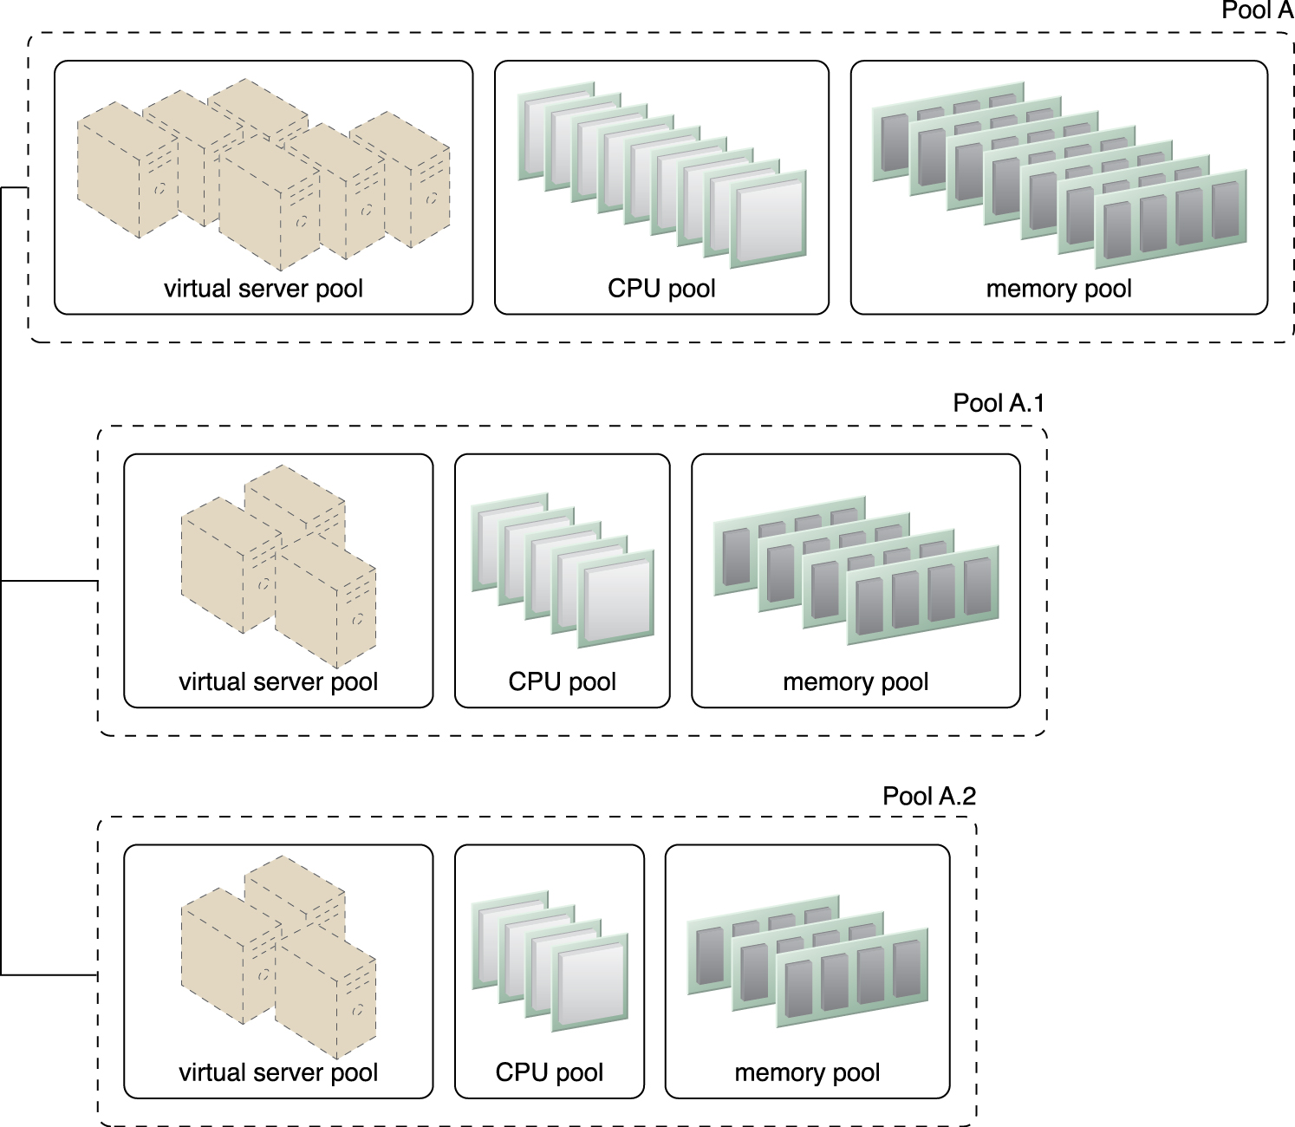
11.2. Resource Pooling Architecture
In the nested pool model, larger pools are divided into smaller pools that individually group the same type of IT resources together
Nested pools can be used to assign resource pools to different departments or groups in the same cloud consumer organization
After resources pools have been defined, multiple instances of IT resources from each pool can be created to provide an in-memory pool of “live” IT resources
Figure 11.4 Nested Pools A.1 and Pool A.2 are comprised of the same IT resources as Pool A, but in different quantities. Nested pools are typically used to provision cloud services that need to be rapidly instantiated using the same type of IT resources with the same configuration settings.
Notes:
Figure:

Slide 11
11.2. Resource Pooling Architecture
Other Resource pooling mechanisms are:
Audit Monitor – This mechanism monitors resource pool usage to ensure compliance with privacy and regulation requirements, especially when pools contain cloud storage devices or data loaded into memory.
Cloud Usage Monitor – Various cloud usage monitors are involved in the runtime tracking and synchronization that are required by the pooled IT resources and any underlying management systems.
Hypervisor – The hypervisor mechanism is responsible for providing virtual servers with access to resource pools, in addition to hosting the virtual servers and sometimes the resource pools themselves.
Logical Network Perimeter – The logical network perimeter is used to logically organize and isolate resource pools.

Slide 12
11.2. Resource Pooling Architecture
Other Resource pooling mechanisms (cont):
Pay-Per-Use Monitor – The pay-per-use monitor collects usage and billing information on how individual cloud consumers are allocated and use IT resources from various pools.
Remote Administration System – This mechanism is commonly used to interface with backend systems and programs in order to provide resource pool administration features via a front-end portal.
Resource Management System – The resource management system mechanism supplies cloud consumers with the tools and permission management options for administering resource pools.
Resource Replication – This mechanism is used to generate new instances of IT resources for resource pools.

Slide 13
11.3. Dynamic Scalability Architecture
The dynamic scalability architecture is an architectural model based on a system of predefined scaling conditions that trigger the dynamic allocation of IT resources from resource pools
Dynamic allocation enables variable utilization as dictated by usage demand fluctuations, since unnecessary IT resources are efficiently reclaimed without requiring manual interaction
The automated scaling listener is configured with workload thresholds that dictate when new IT resources need to be added to the workload processing.
ALS can be provided with logic that determines how many additional IT resources can be dynamically provided, based on the terms of a given cloud consumer’s provisioning contract

Slide 14
11.3. Dynamic Scalability Architecture
Dynamic scaling type:
Dynamic Horizontal Scaling – IT resource instances are scaled out and in to handle fluctuating workloads. The automatic scaling listener monitors requests and signals resource replication to initiate IT resource duplication, as per requirements and permissions.
Dynamic Vertical Scaling – IT resource instances are scaled up and down when there is a need to adjust the processing capacity of a single IT resource. For example, a virtual server that is being overloaded can have its memory dynamically increased or it may have a processing core added.
Dynamic Relocation – The IT resource is relocated to a host with more capacity. For example, a database may need to be moved from a tape-based SAN storage device with 4 GB per second I/O capacity to another disk-based SAN storage device with 8 GB per second I/O capacity.

Slide 15
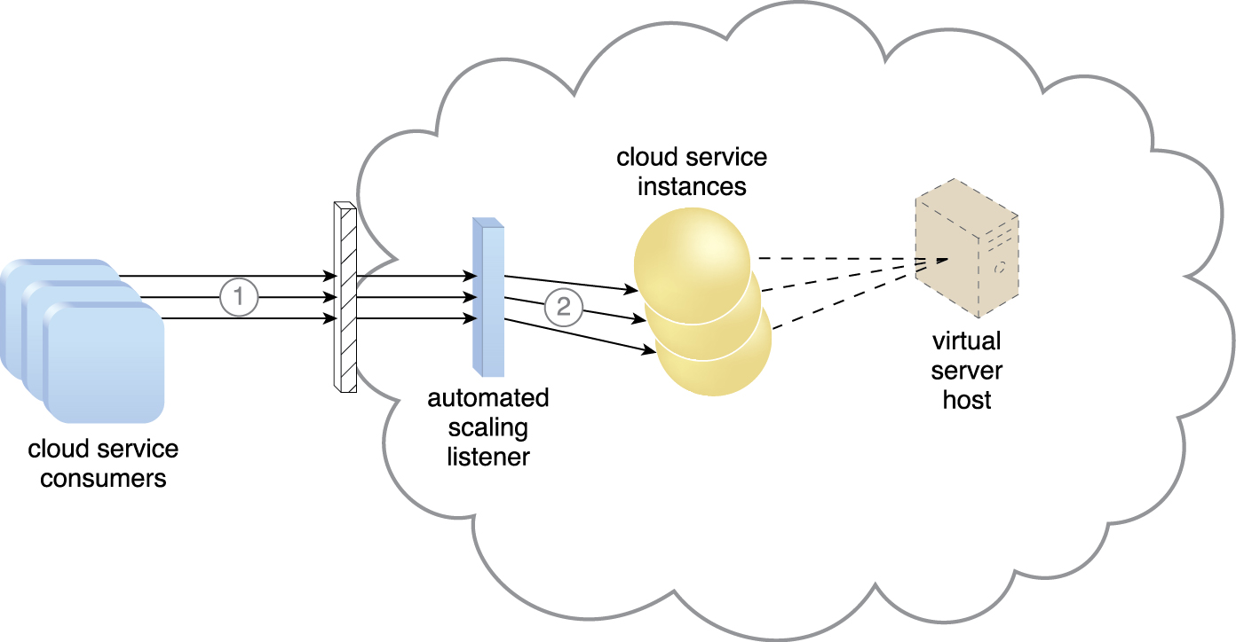
11.3. Dynamic Scalability Architecture
Cloud service consumers are sending requests to a cloud service (1)
The automated scaling listener monitors the cloud service to determine if predefined capacity thresholds are being exceeded (2).
Figure 11.5
Notes:
Figure:

Slide 16
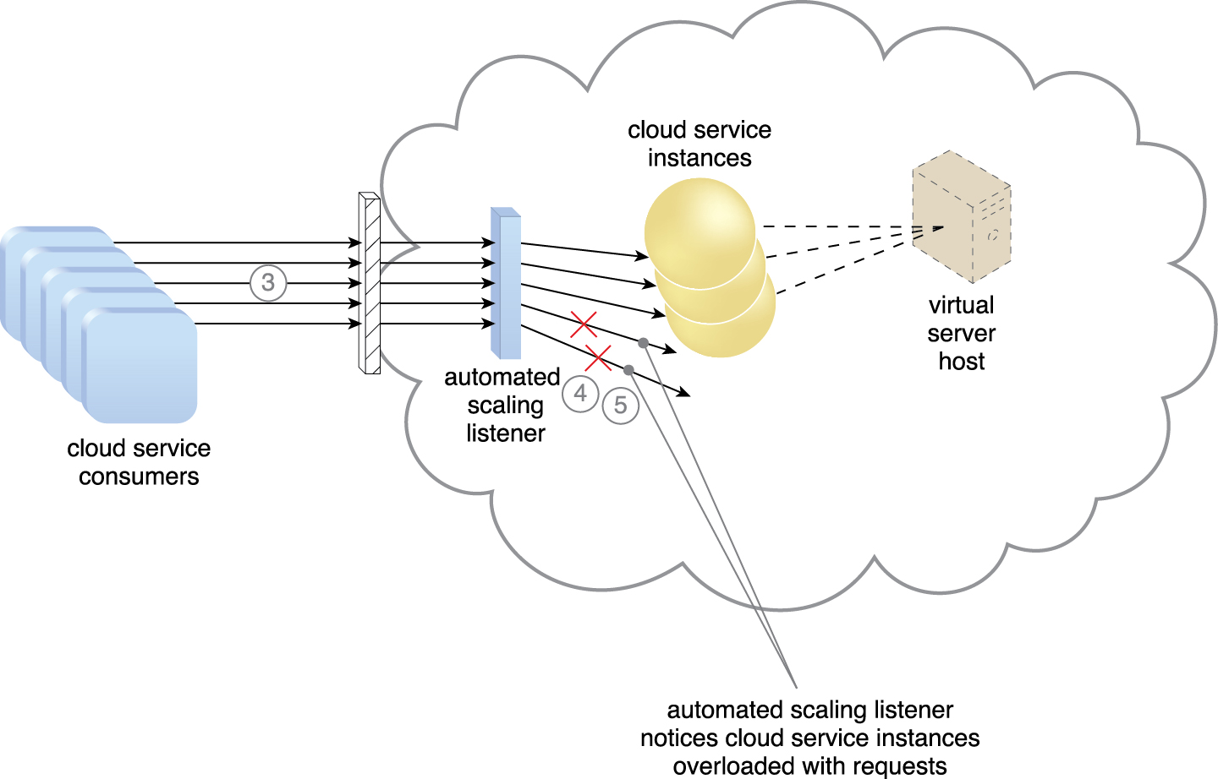
11.3. Dynamic Scalability Architecture
The number of requests coming from cloud service consumers increases (3)
The workload exceeds the performance thresholds. The automated scaling listener determines the next course of action based on a predefined scaling policy (4)
If the cloud service implementation is deemed eligible for additional scaling, the automated scaling listener initiates the scaling process (5).
Figure 11.6
Notes:
Figure:

Slide 17
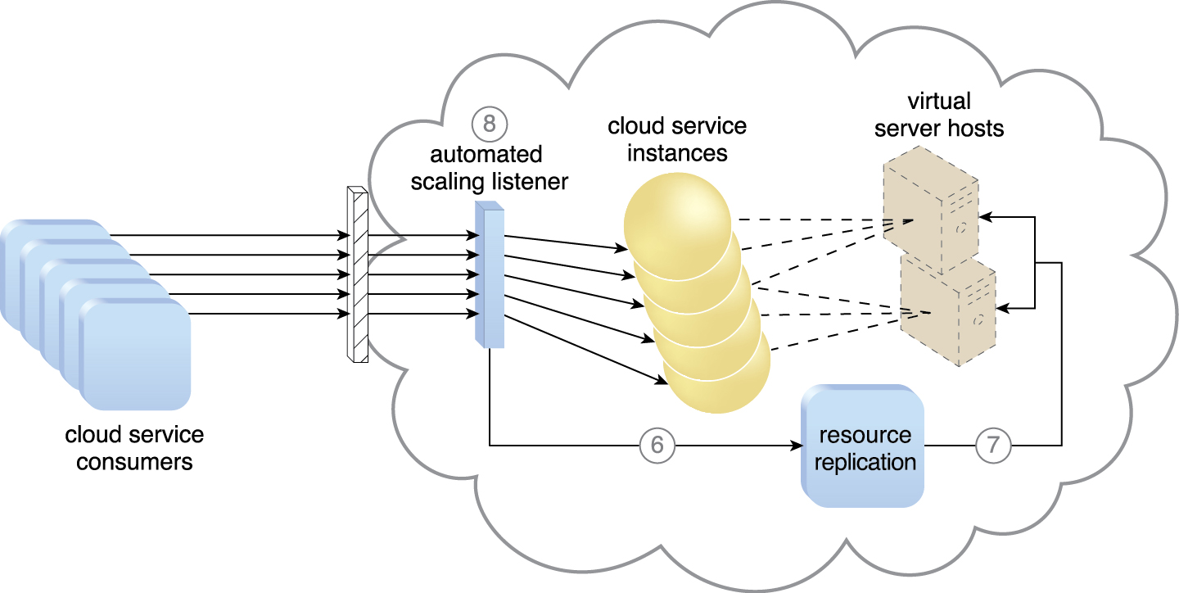
11.3. Dynamic Scalability Architecture
The automated scaling listener sends a signal to the resource replication mechanism (6)
which creates more instances of the cloud service (7)
Now that the increased workload has been accommodated, the automated scaling listener resumes monitoring and detracting and adding IT resources, as required (8).
Figure 11.7
Notes:
Figure:

Slide 18
11.3. Dynamic Scalability Architecture
The dynamic scalability architecture can be applied to a range of IT resources, including virtual servers and cloud storage devices
Besides the core automated scaling listener and resource replication mechanisms, the following mechanisms can also be used in this form of cloud architecture:
Cloud Usage Monitor – Specialized cloud usage monitors can track runtime usage in response to dynamic fluctuations caused by this architecture.
Hypervisor – The hypervisor is invoked by a dynamic scalability system to create or remove virtual server instances, or to be scaled itself.
Pay-Per-Use Monitor – The pay-per-use monitor is engaged to collect usage cost information in response to the scaling of IT resources.

Slide 19
11.4. Elastic Resource Capacity Architecture
The elastic resource capacity architecture is primarily related to the dynamic provisioning of virtual servers, using a system that allocates and reclaims CPUs and RAM in immediate response to the fluctuating processing requirements of hosted IT resources
Resource pools are used by scaling technology that interacts with the hypervisor and/or VIM to retrieve and return CPU and RAM resources at runtime.
The runtime processing of the virtual server is monitored so that additional processing power can be leveraged from the resource pool via dynamic allocation, before capacity thresholds are met.
The virtual server and its hosted applications and IT resources are vertically scaled in response
Virtual servers that participate in elastic resource allocation systems may require rebooting in order for the dynamic resource allocation to take effect.

Slide 20
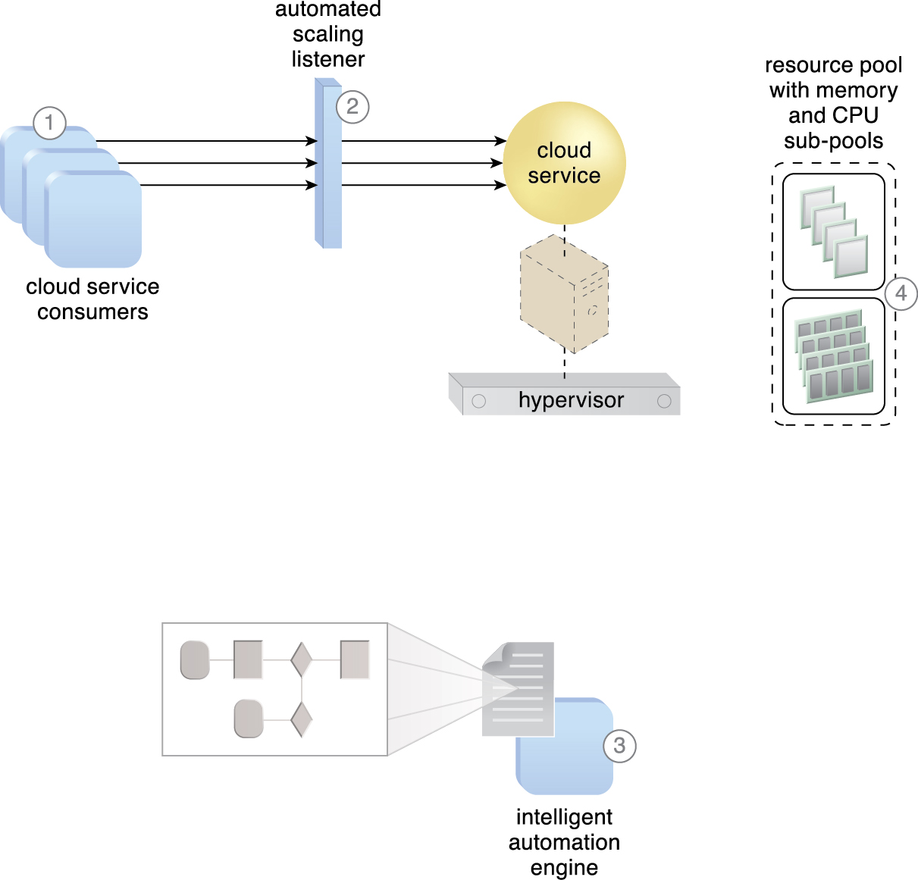
11.4. Elastic Resource Capacity Architecture
Cloud service consumers are actively sending requests to a cloud service (1),
which are monitored by an automated scaling listener (2)
An intelligent automation engine script is deployed with workflow logic (3)
that is capable of notifying the resource pool using allocation requests (4).
Figure 11.8
Notes:
Figure:

Slide 21
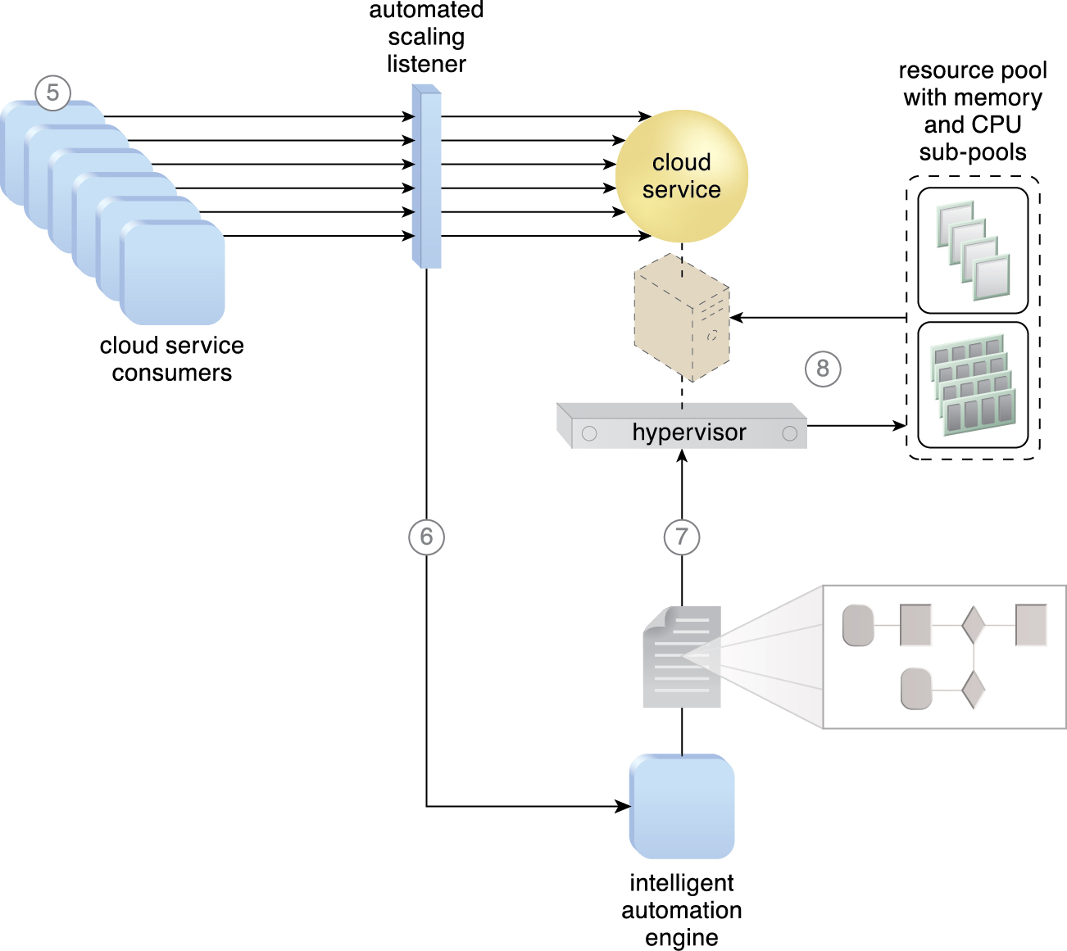
11.4. Elastic Resource Capacity Architecture
Cloud service consumer requests increase (5),
causing the automated scaling listener to signal the intelligent automation engine to execute the script (6).
The script runs the workflow logic that signals the hypervisor to allocate more IT resources from the resource pools (7)
The hypervisor allocates additional CPU and RAM to the virtual server, enabling the increased workload to be handled (8).
Figure 11.9
Notes:
Figure:

Slide 22
11.4. Elastic Resource Capacity Architecture
Additional mechanisms to Elastic Resource Capacity:
Cloud Usage Monitor – Specialized cloud usage monitors collect resource usage information on IT resources before, during, and after scaling, to help define the future processing capacity thresholds of the virtual servers.
Pay-Per-Use Monitor – The pay-per-use monitor is responsible for collecting resource usage cost information as it fluctuates with the elastic provisioning.
Resource Replication – Resource replication is used by this architectural model to generate new instances of the scaled IT resources.

Slide 23
11.5. Service Load Balancing Architecture
The service load balancing architecture can be considered a specialized variation of the workload distribution architecture
geared specifically for scaling cloud service implementations.
Redundant deployments of cloud services are created, with a load balancing system added to dynamically distribute workloads.
The duplicate cloud service implementations are organized into a resource pool, while the load balancer is positioned as either an external or built-in component to allow the host servers to balance the workloads themselves
Depending on workload and processing capacity of host server environments, multiple instances of each cloud service implementation can be generated as part of a resource pool that responds to fluctuating request volumes more efficiently
The load balancer can be positioned either independent of the cloud services and their host servers, or built-in as part of the application or server’s environment. In the latter case, a primary server with the load balancing logic can communicate with neighboring servers to balance the workload

Slide 24
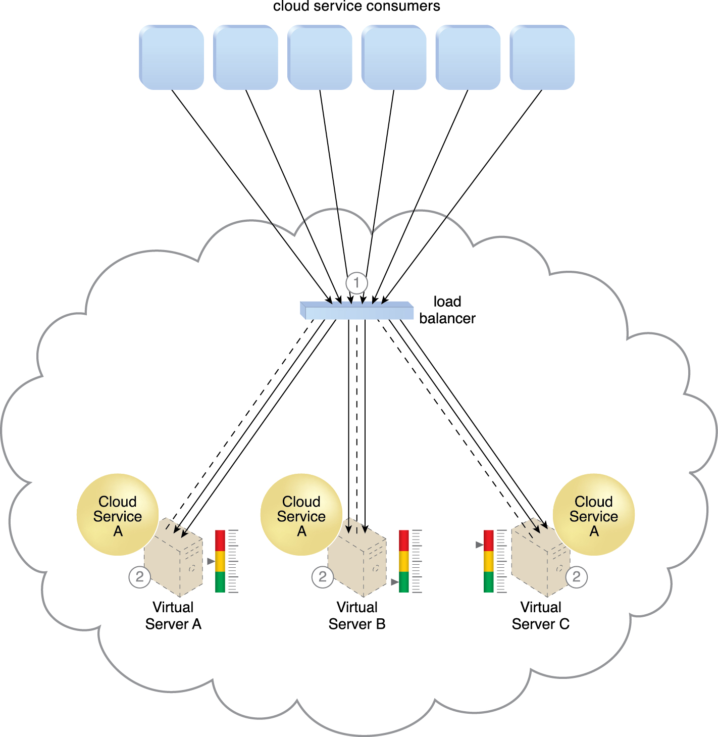
11.5. Service Load Balancing Architecture
The external load balancer intercepts messages sent by cloud service consumers (1)
And forwards them to the virtual servers so that the workload processing is horizontally scaled (2).
Figure 11.10
Notes:
Figure:

Slide 25
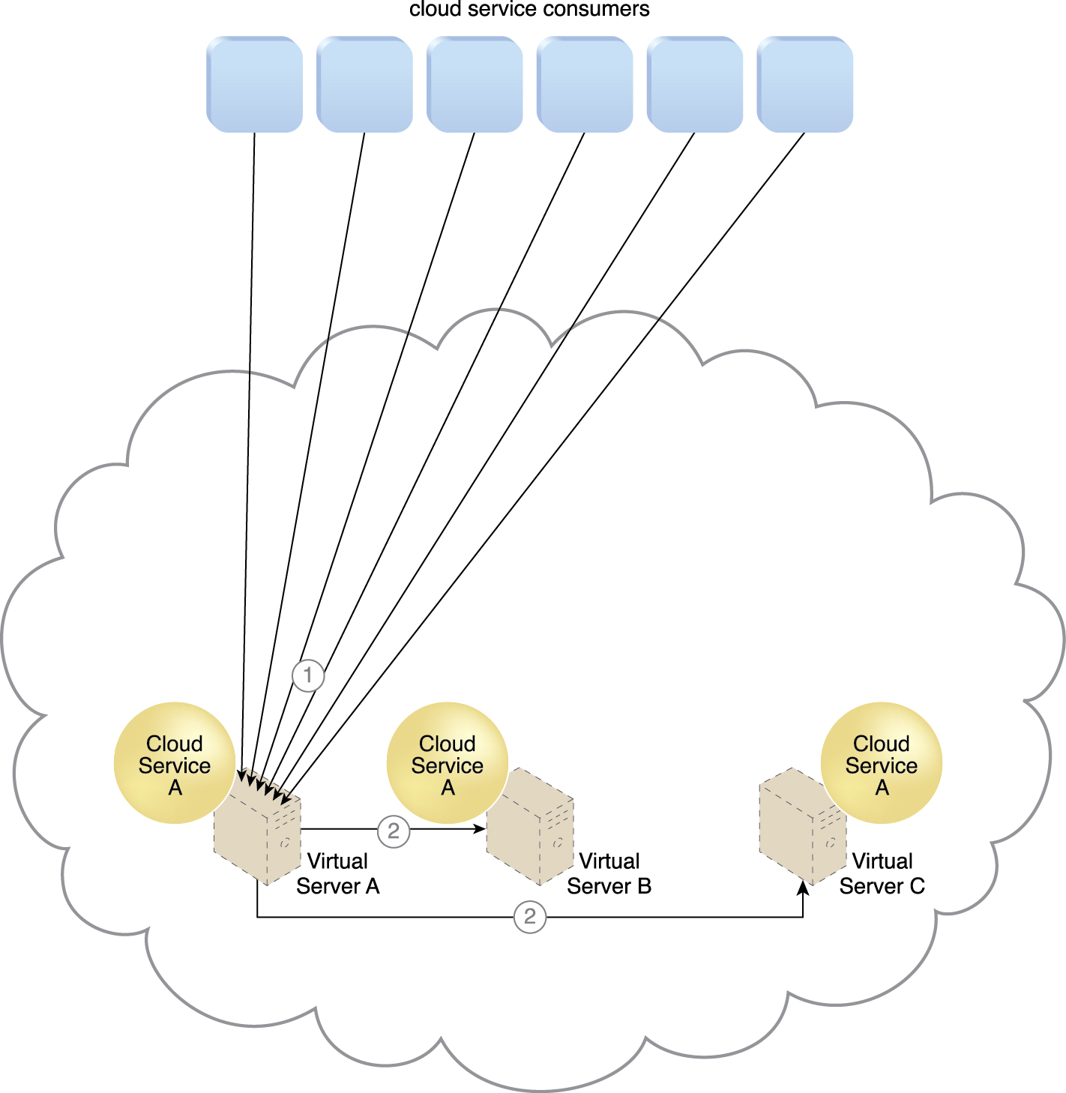
11.5. Service Load Balancing Architecture
Cloud service consumer requests are sent to Cloud Service A on Virtual Server A (1).
The cloud service implementation includes built-in load balancing logic that is capable of distributing requests to the neighboring Cloud Service A implementations on Virtual Servers B and C (2).
Figure 11.11
Notes:
Figure:

Slide 26
11.5. Service Load Balancing Architecture
The service load balancing architecture can involve the following mechanisms in addition to the load balancer:
Cloud Usage Monitor – Cloud usage monitors may be involved with monitoring cloud service instances and their respective IT resource consumption levels, as well as various runtime monitoring and usage data collection tasks.
Resource Cluster – Active-active cluster groups are incorporated in this architecture to help balance workloads across different members of the cluster.
Resource Replication – The resource replication mechanism is utilized to generate cloud service implementations in support of load balancing requirements.

Slide 27
11.6. Cloud Bursting Architecture
The cloud bursting architecture establishes a form of dynamic scaling that scales or “bursts out” on-premise IT resources into a cloud whenever predefined capacity thresholds have been reached
The corresponding cloud-based IT resources are redundantly pre-deployed but remain inactive until cloud bursting occurs and then the architecture “bursts in” back to the on-premise environment when resources are no longer needed
Cloud bursting is a flexible scaling architecture that provides cloud consumers with the option of using cloud-based IT resources only to meet higher usage demands based on the automated scaling listener and resource replication mechanisms.
The automated scaling listener determines when to redirect requests to cloud-based IT resources, and resource replication is used to maintain synchronicity between on-premise and cloud-based IT resources in relation to state information

Slide 28
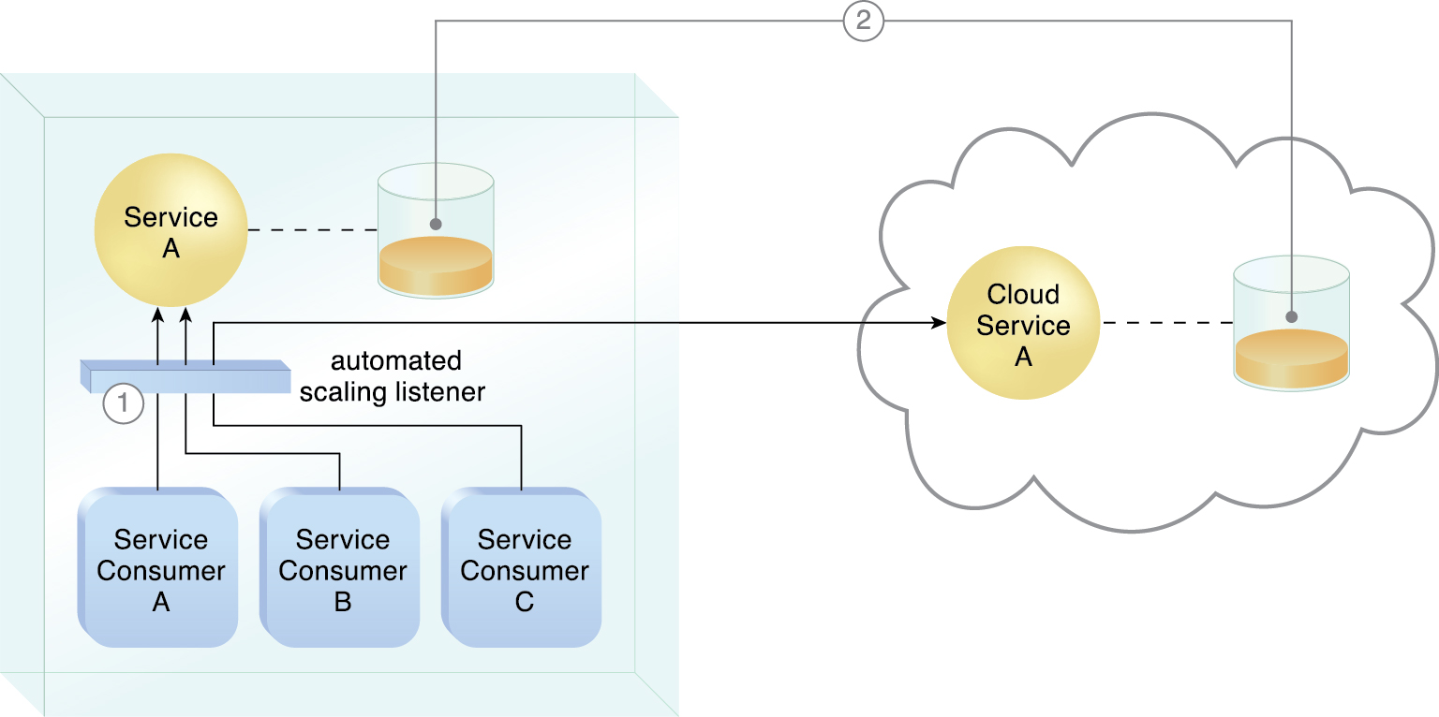
11.6. Cloud Bursting Architecture
An automated scaling listener monitors the usage of on-premise Service A, and redirects Service Consumer C’s request to Service A’s redundant implementation in the cloud (Cloud Service A) once Service A’s usage threshold has been exceeded (1).
A resource replication system is used to keep state management databases synchronized (2).
Figure 11.12
Notes:
Figure:

Slide 29
11.7. Elastic Disk Provisioning Architecture
Cloud consumers are commonly charged for cloud-based storage space based on fixed-disk storage allocation, meaning the charges are predetermined by disk capacity and not aligned with actual data storage consumption

Slide 30
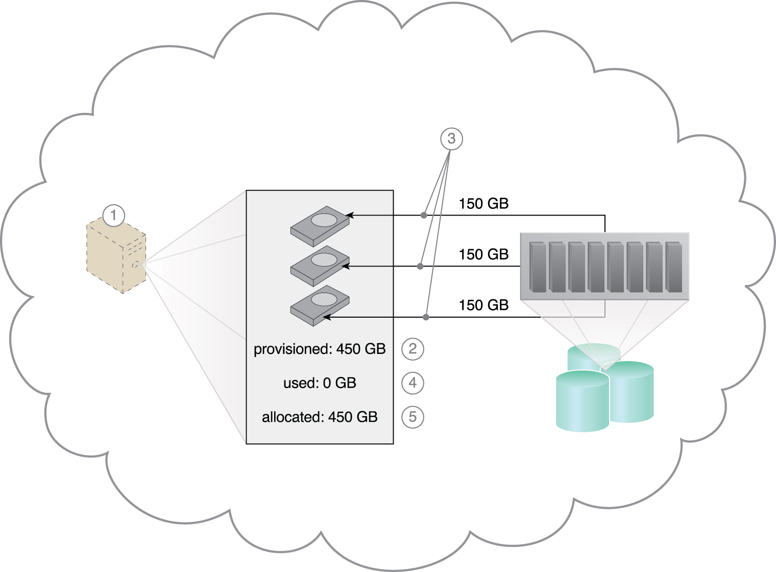
11.7. Elastic Disk Provisioning Architecture
The cloud consumer requests a virtual server with three hard disks, each with a capacity of 150 GB (1).
The virtual server is provisioned according to the elastic disk provisioning architecture, with a total of 450 GB of disk space (2).
The 450 GB is allocated to the virtual server by the cloud provider (3).
The cloud consumer has not installed any software yet, meaning the actual used space is currently 0 GB (4).
Because the 450 GB are already allocated and reserved for the cloud consumer, it will be charged for 450 GB of disk usage as of the point of allocation (5).
Figure 11.13
Notes:
Figure:

Slide 31
11.7. Elastic Disk Provisioning Architecture
The elastic disk provisioning architecture establishes a dynamic storage provisioning system that ensures that the cloud consumer is granularly billed for the exact amount of storage that it actually uses
uses thin-provisioning technology for the dynamic allocation of storage space, and is further supported by runtime usage monitoring to collect accurate usage data for billing purposes
Thin-provisioning software is installed on virtual servers that process dynamic storage allocation via the hypervisor, while the pay-per-use monitor tracks and reports granular billing-related disk usage data

Slide 32
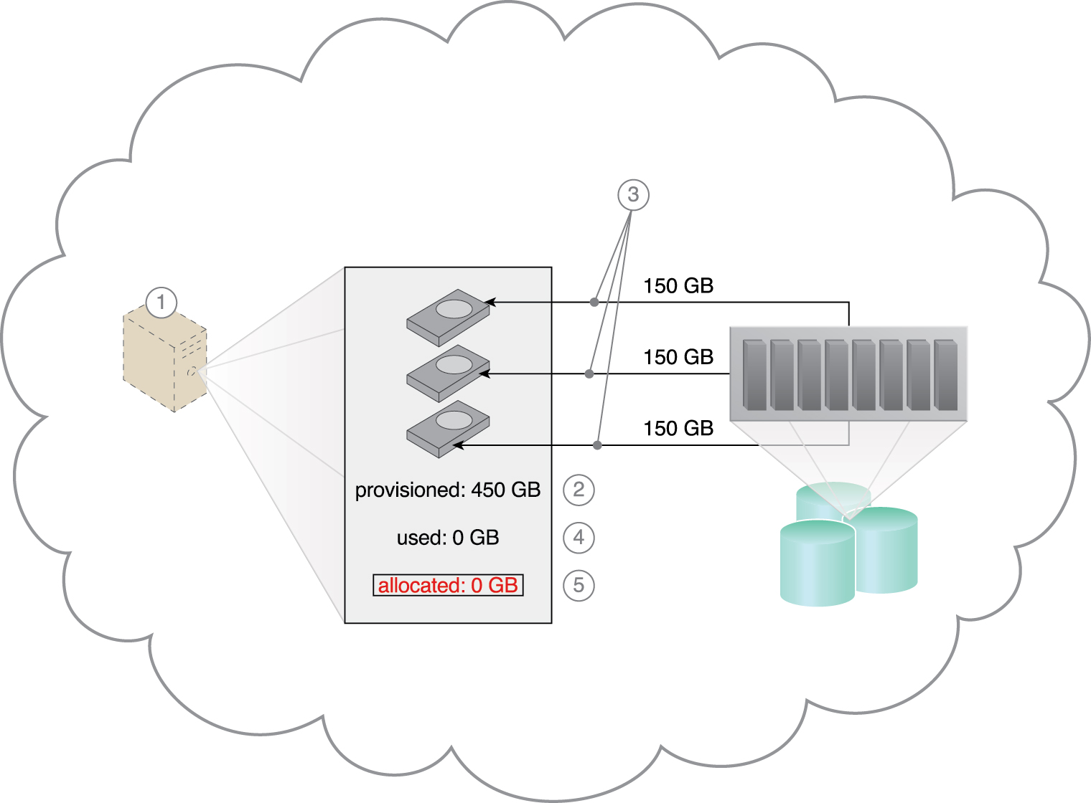
11.7. Elastic Disk Provisioning Architecture
The cloud consumer requests a virtual server with three hard disks, each with a capacity of 150 GB (1). The virtual server is provisioned by this architecture with a total of 450 GB of disk space (2)
The 450 GB are set as the maximum disk usage that is allowed for this virtual server, although no physical disk space has been reserved or allocated yet (3)
The cloud consumer has not installed any software, meaning the actual used space is currently at 0 GB (4)
Because the allocated disk space is equal to the actual used space (which is currently at zero), the cloud consumer is not charged for any disk space usage (5).
Figure 11.14
Notes:
Figure:

Slide 33
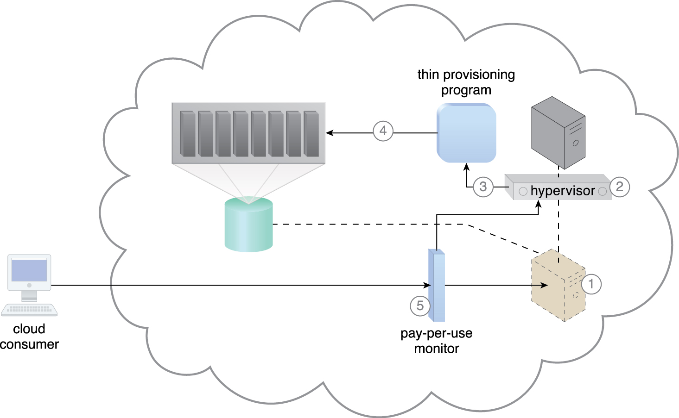
11.7. Elastic Disk Provisioning Architecture
A request is received from a cloud consumer, and the provisioning of a new virtual server instance begins (1).
As part of the provisioning process, the hard disks are chosen as dynamic or thin-provisioned disks (2).
The hypervisor calls a dynamic disk allocation component to create thin disks for the virtual server (3).
Virtual server disks are created via the thin-provisioning program and saved in a folder of near-zero size. The size of this folder and its files grow as operating applications are installed and additional files are copied onto the virtual server (4).
The pay-per-use monitor tracks the actual dynamically allocated storage for billing purposes (5).
Figure 11.15
Notes:
Figure:

Slide 34
11.7. Elastic Disk Provisioning Architecture
The following mechanisms can be included in this architecture in addition to the cloud storage device, virtual server, hypervisor, and pay-per-use monitor:
Cloud Usage Monitor – Specialized cloud usage monitors can be used to track and log storage usage fluctuations
Resource Replication – Resource replication is part of an elastic disk provisioning system when conversion of dynamic thin-disk storage into static thick-disk storage is required

Slide 35
11.8. Redundant Storage Architecture
Cloud storage devices are occasionally subject to failure and disruptions that are caused by network connectivity issues, controller or general hardware failure, or security breaches.
A compromised cloud storage device’s reliability can have a ripple effect and cause impact failure across all of the services, applications, and infrastructure components in the cloud that are reliant on its availability
A logical unit number (LUN) is a logical drive that represents a partition of a physical drive
The storage service gateway is a component that acts as the external interface to cloud storage services, and is capable of automatically redirecting cloud consumer requests whenever the location of the requested data has changed

Slide 36
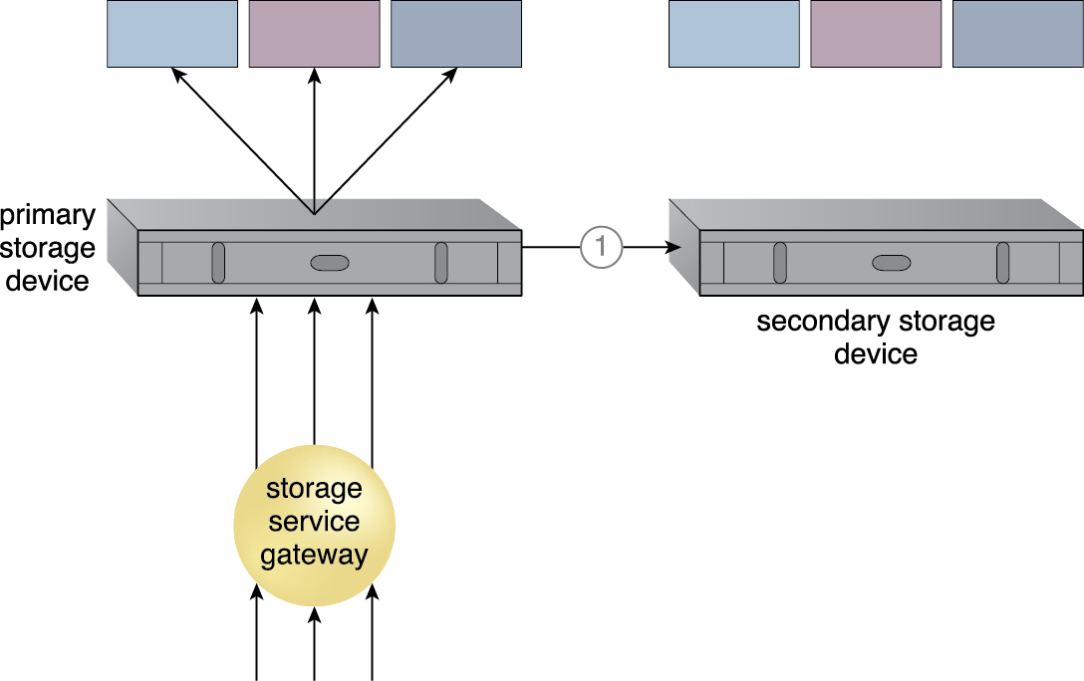
11.8. Redundant Storage Architecture
The redundant storage architecture introduces a secondary duplicate cloud storage device as part of a failover system that synchronizes its data with the data in the primary cloud storage device.
A storage service gateway diverts cloud consumer requests to the secondary device whenever the primary device fails
The primary cloud storage device is routinely replicated to the secondary cloud storage device (1).
Figure 11.16
Notes:
Figure:

Slide 37
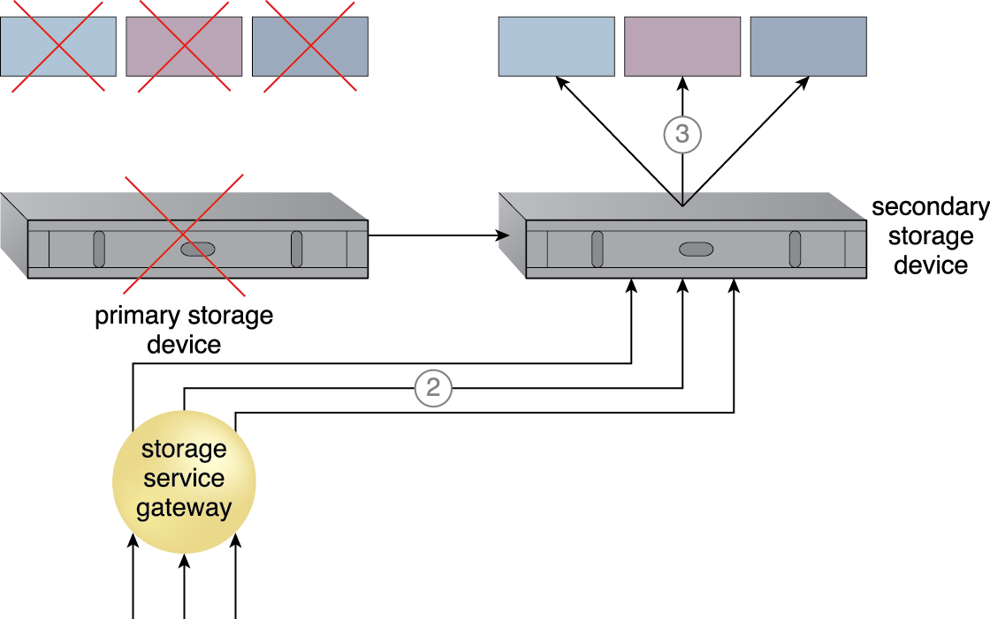
11.8. Redundant Storage Architecture
The primary storage becomes unavailable and the storage service gateway forwards the cloud consumer requests to the secondary storage device (2)
The secondary storage device forwards the requests to the LUNs, allowing cloud consumers to continue to access their data (3).
Figure 11.17
Notes:
Figure:

Slide 38
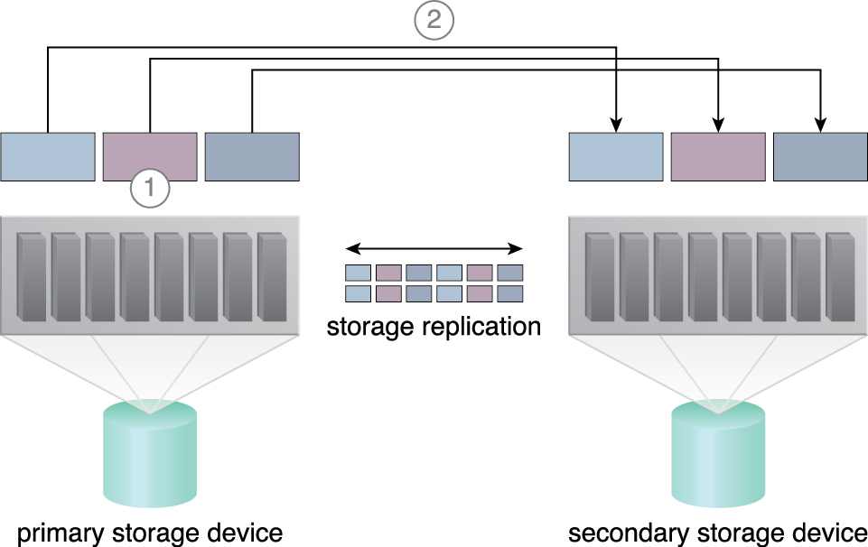
11.8. Redundant Storage Architecture
This cloud architecture primarily relies on a storage replication system that keeps the primary cloud storage device synchronized with its duplicate secondary cloud storage devices
Storage replication is a variation of the resource replication mechanisms used to synchronously or asynchronously replicate data from a primary storage device to a secondary storage device. It can be used to replicate partial and entire LUNs
Figure 11.18 Storage replication is used to keep the redundant storage device synchronized with the primary storage device.
Notes:
Figure:

Slide 39
11.8. Redundant Storage Architecture
Cloud providers may locate secondary cloud storage devices in a different geographical region than the primary cloud storage device, usually for economic reasons.
this can introduce legal concerns for some types of data.
The location of the secondary cloud storage devices can dictate the protocol and method used for synchronization, as some replication transport protocols have distance restrictions.
Some cloud providers use storage devices with dual array and storage controllers to improve device redundancy, and place secondary storage devices in a different physical location for cloud balancing and disaster recovery purposes.
cloud providers may need to lease a network connection via a third-party cloud provider in order to establish the replication between the two devices

Slide 40
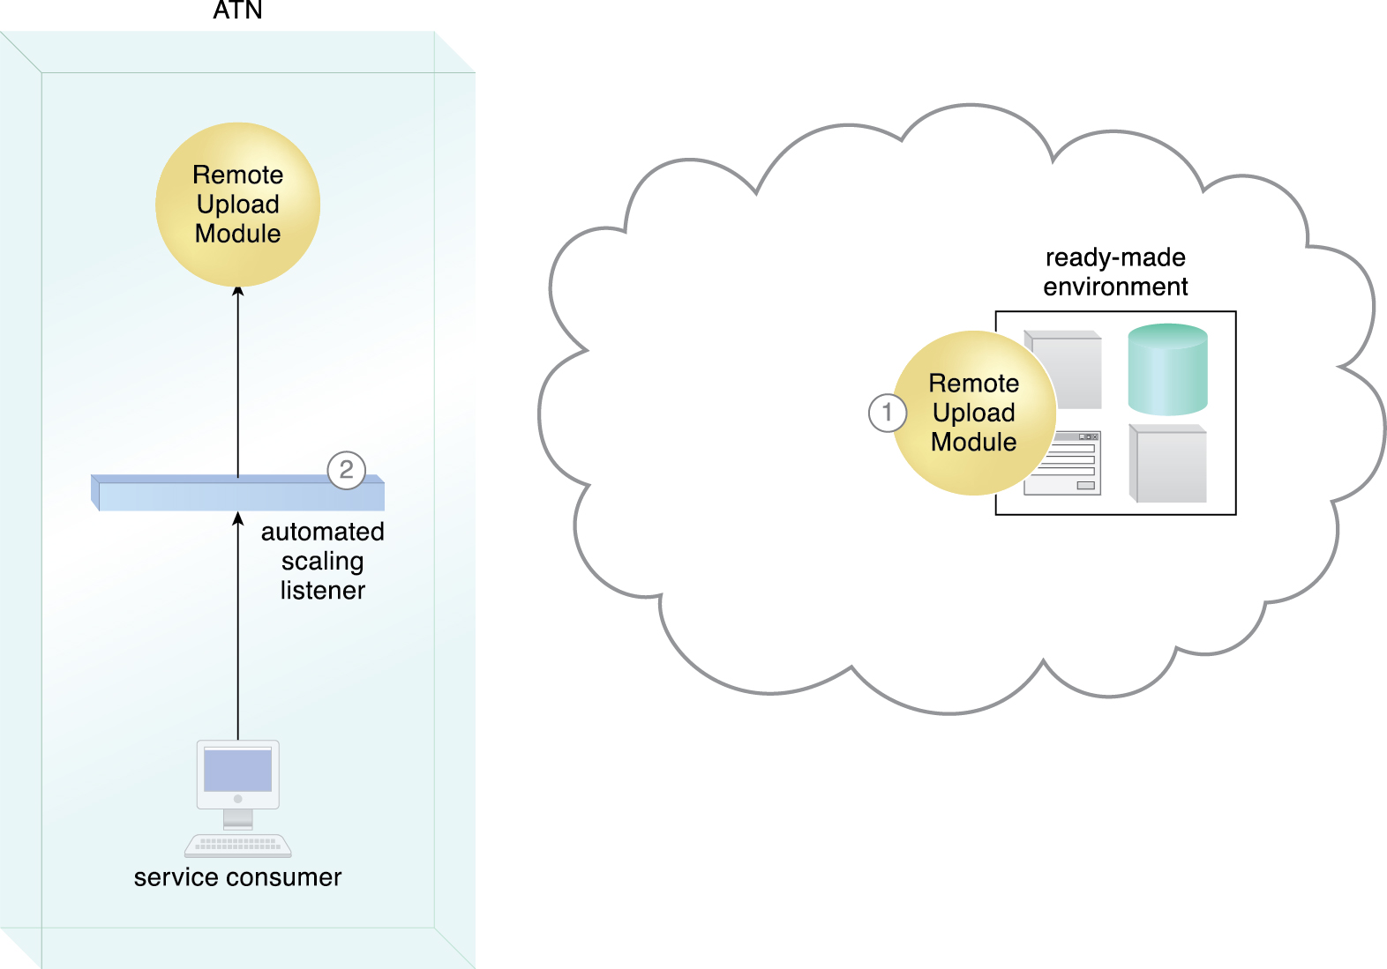
11.9. Case Study Example
ATM Remote Upload Module (for account and legal docs) will reject upload attempts when capacity is reached. Decided to use a Cloud-bursting architecture
A cloud-based version of the on-premise Remote Upload Module service is deployed on ATN’s leased ready-made environment (1).
The automated scaling listener monitors service consumer requests (2).
Figure 11.19
Notes:
Figure:

Slide 41
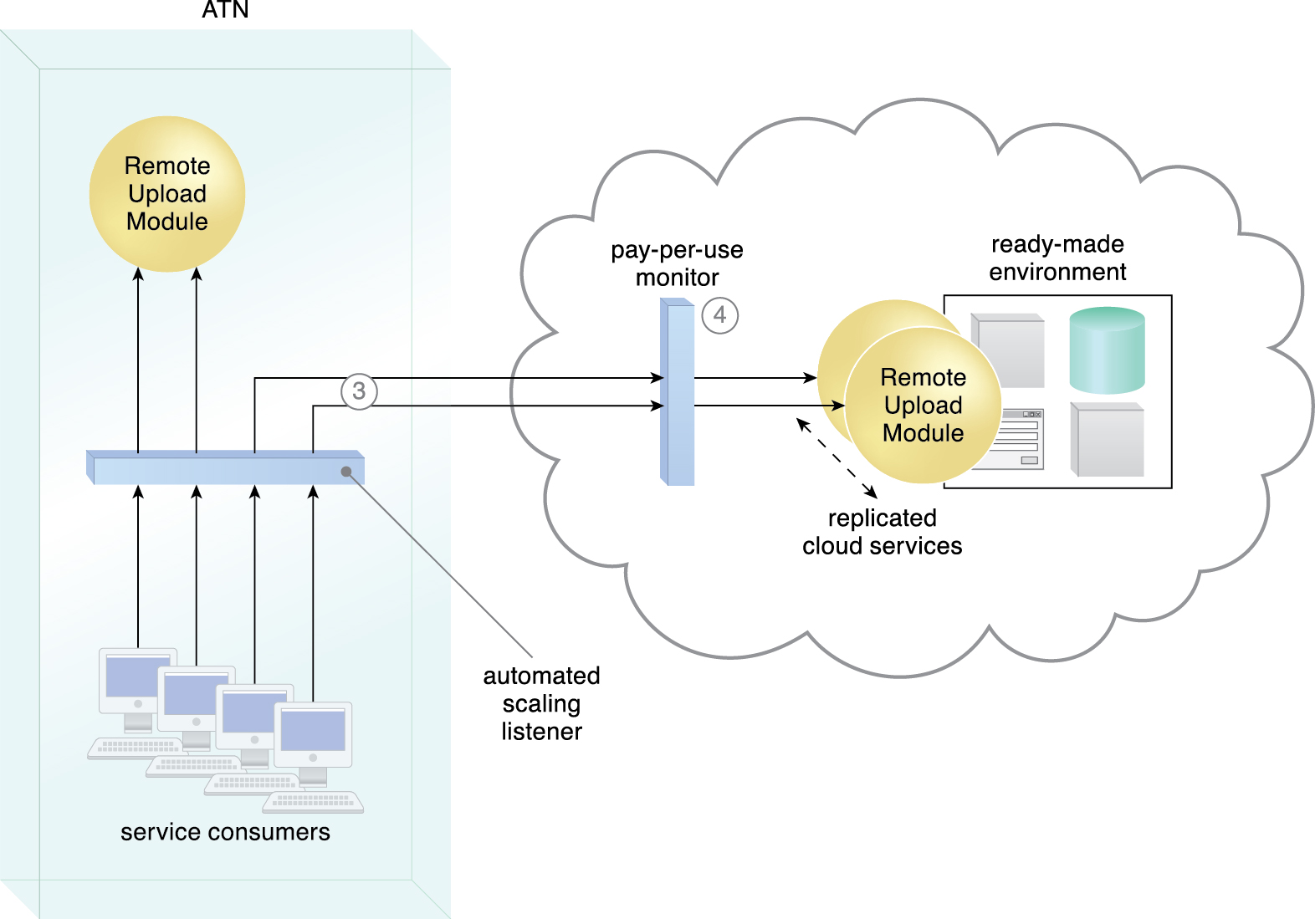
11.9. Case Study Example
The automated scaling listener detects that service consumer usage has exceeded the local Remote Upload Module service’s usage threshold, and begins diverting excess requests to the cloud-based Remote Upload Module implementation (3).
The cloud provider’s pay-per-use monitor tracks the requests received from the on-premise automated scaling listener to collect billing data, and Remote Upload Module cloud service instances are created on-demand via resource replication (4).
Figure 11.20
Notes:
Figure:

